Slide 1
Frontend Server Side Render
Writer : Kevin

Slide 2


Client Side Render (CSR)
我要畫一隻豬
畫筆 ＆ 樣板

Slide 3

Server Side Render (SSR)
我要畫一隻豬

Slide 4
CSR
Any framework ( Angular, React, Vue )
Webpack
Babel
HTML ( html5 )
CSS ( sass, less )
Javascript ( ES6, ES7, ES8,… )
Node.js

Slide 5
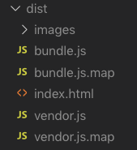
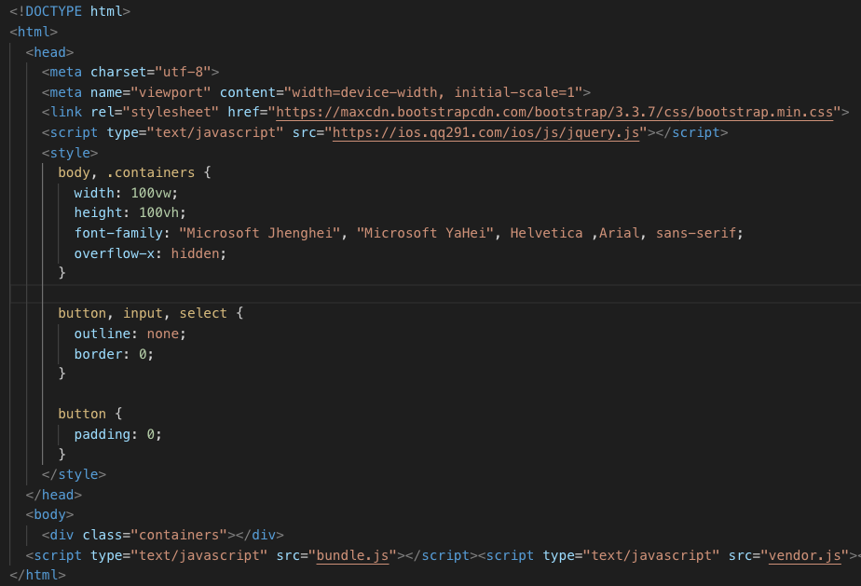
CSR

Slide 6
SSR
Any framework ( Angular, React, Vue )
Webpack
Babel
HTML ( html5 )
CSS ( sass, less )
Javascript ( ES6, ES7, ES8,… )
Node.js
Next.js
Express.js
Web Server ( Nginx, IIS )

Slide 7
CSR
Need SSR of Pages
General CSR of Pages

